Slide 1


Slide 2
Selenium Training
Kamalesh
Evry

Slide 3
Agenda
Selenium
TestNG
TestNG Annotations
Selenium + TestNG + ReportNG

Slide 4
TestNG
TestNG is a testing framework written in Java and inspired from JUnit and NUnit.
Results in reliable, maintainable and testable code
The main features are as follows:
Annotations
Test code to be multithread safe
Uses XML to do flexible test configuration
Support for data-driven testing (with @DataProvider)
Supports ignore, time-driven, parameters, test suites, tests and exception tests, etc.

Slide 5
TestNG Annotations
Annotation name | Documentation
@BeforeSuite | The annotated method will be run before all tests in this suite have run.
@BeforeGroups | The Annotated method will run before the first method in any of the specified groups is invoked.
@BeforeClass | The Annotated method will be run before the first method on the current test class is invoked.
@BeforeTest | The Annotated method will be run before any test method in a given is invoked.
@BeforeMethod | The Annotated method will be run before each test method.
@AfterMethod | The Annotated method will be run after each test method.
@AfterTest | The Annotated method will be run after all the test methods in a given have been run.
@AfterClass | The Annotated method that will be run after the last test method on the current class is run.
@AfterGroups | The Annotated method that will be run after the last test method belonging to the groups specified in its value attribute has been invoked.
@AfterSuite | The annotated method will be run after all tests in this suite have run.

Slide 6
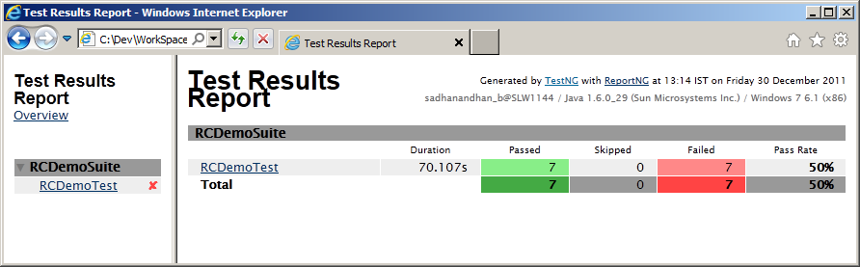
Selenium + TestNG + ReportNG
TestNG as a framework helps with Annotating the test methods
Assertions enabled from within TestNG
ReportNG enables customizable reporting of results

Slide 7
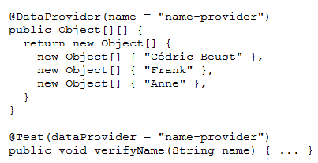
Data Driven Testing
Support for data-driven testing (with @DataProvider)

Slide 8
Example
public class TestNgTest {
WebDriver driver;
@BeforeTest
public void before(){
System.setProperty("webdriver.ie.driver","IEDriverServer.exe");
driver = new InternetExplorerDriver();
driver.get("http://google.com");
}
@Test
public void Test01() {
WebElement textbox = driver.findElement(By.name("q"));
textbox.sendKeys("hello!");
}
@AfterTest
public void teminate() {
driver.close();
driver.quit();
}
}

